Slide 1
Measurement Principles

Slide 2
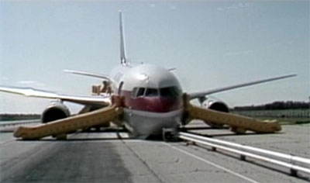
Gimli Glider
• July 23, 1983-this Boeing 767 ran out of fuel!

Slide 3
Measurement Error
Random Error
Experimental conditions that make measurements difficult. Every measurement with the same equipment is slightly different.
Systematic Error
A problem with a measuring device that gives consistent measurements but off by a fixed amount.
Human Error / Carelesness
I don’t want to hear about it!
Fix the problem!
Redo The Experiment Properly!

Slide 4
Measurement uncertainty and Significant digits
Record all certain digits in a measurement plus last estimated or uncertain digit
E.g. a length of 10.2 ± 0.1 cm
state measurement error
All of the digits in this measurement are significant!

Slide 5
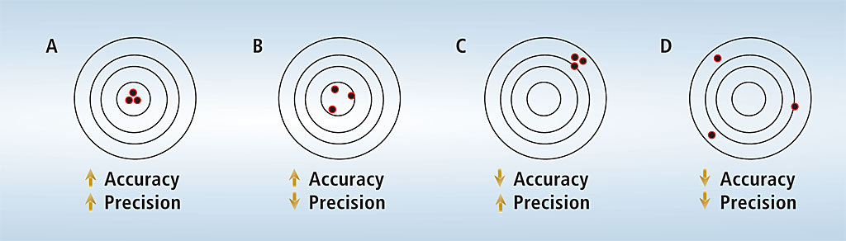
Accuracy versus Precision
Accuracy is related to the correctness of a measurement
Precision is related to the repeatability of a measurement

Slide 6
Significant Digits:
All digits in a measured number are significant EXCEPT:
●leading zeros for decimal numbers (as they are placeholders)
●trailing zeros for whole numbers (as they are placeholders)
Counted Values are considered EXACT (infinite significant digits)
Examples:
3 sig digs
6.05 kg : ________________
0.1255 s : ________________
4 sig digs
120 m : ________________
2 sig digs
60.00 mL : ________________
4 sig digs
Infinite sig digs
30 students: ______________
2 sig digs
0.0025 g: ________________

Slide 7
Scientific Notation
For Large numbers
Count the “zero” places up-to the leading digit
1,200,000 (1.2 million)
6 places ➔ 1.2 x 10⁶
348 ( 3 hundred and 48)
2 places ➔ 3.48 x 10²
For Small Numbers
Count the “zero” places past the leading digit
0.001m (or 1 milli-meter)
3 places ➔ 1.0 x 10⁻³
0.0123m (or 1.23 centi-meter)
2 places ➔ 1.23 x 10⁻²

Slide 8
Weakest Link Rules
When Adding or Subtracting…
Logic:
What is 1.2 Billion plus 34?
1,200,000,000 + 34 = 1,200,000,034
The final answer should contain the same number of decimal places as the least precise number
100.45 g + 23.2 g + 6.11g = ________

Slide 9
Weakest Link Rules
When Multiplying or Dividing…
The final answer should contain the same number of significant digits as the least precise number
32.3 g x 2.25 g = ________

Slide 10
Rounding Numbers
Round to nearest whole number
2.6
2.4
2.51
2.49
Round to nearest whole number
2.50
3.50

